Slide 1
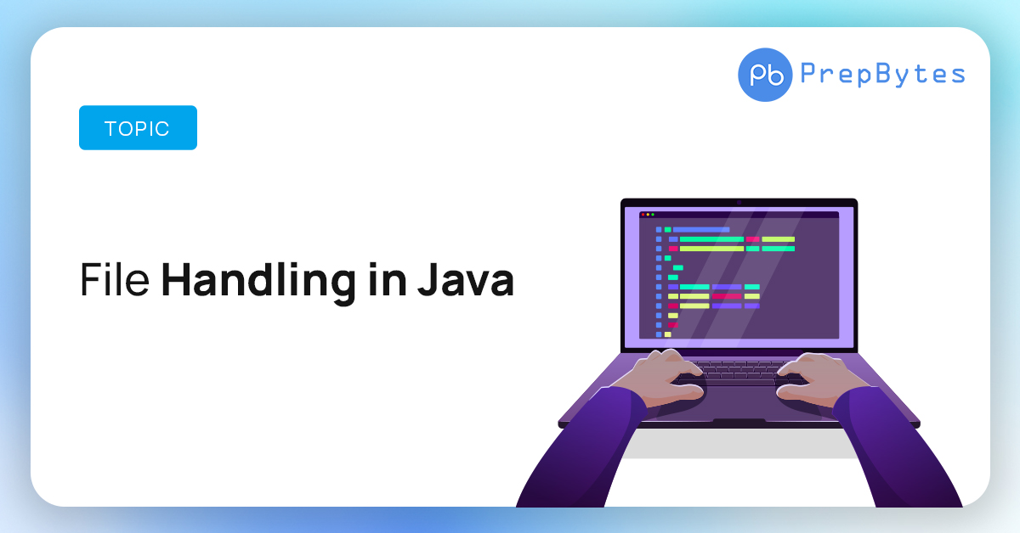

Slide 2
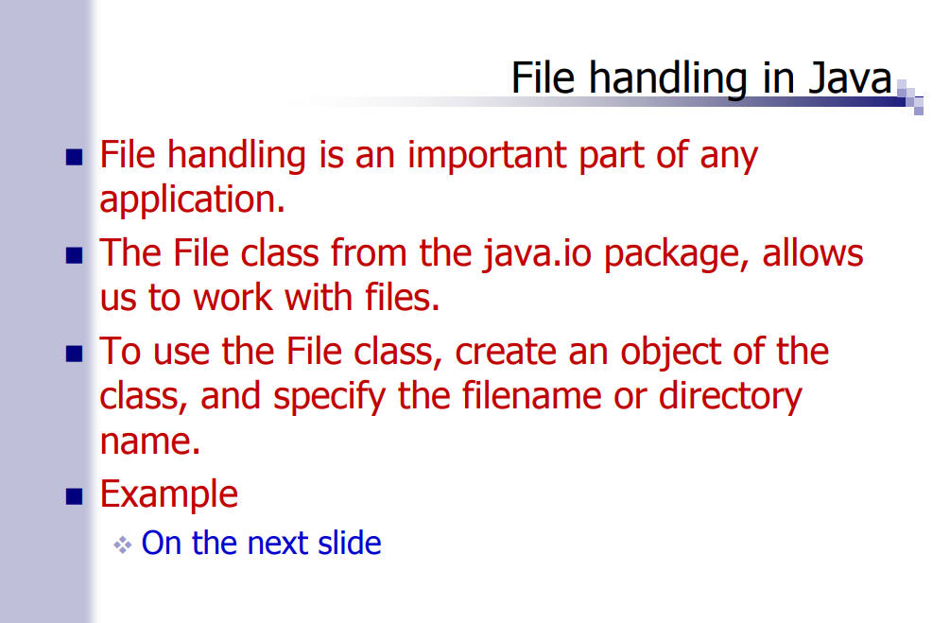

Slide 3
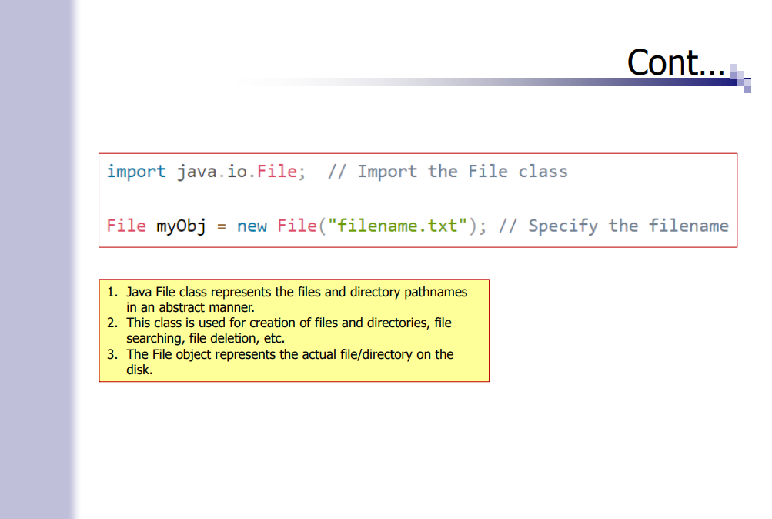

Slide 4
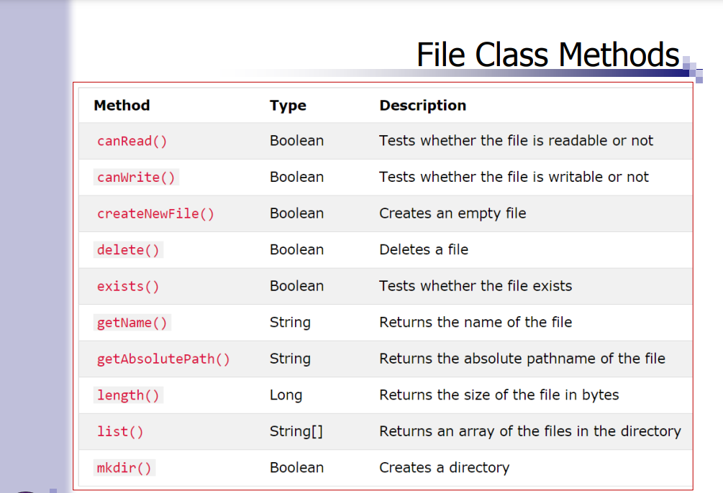

Slide 5
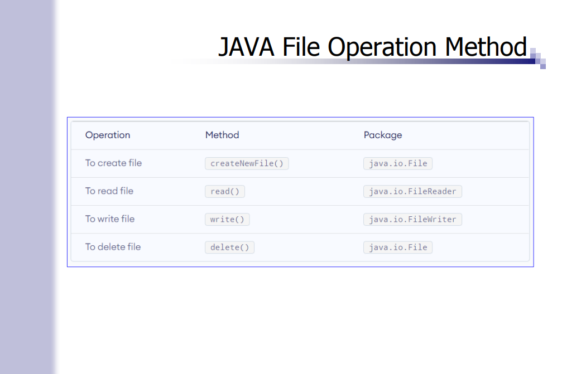

Slide 6
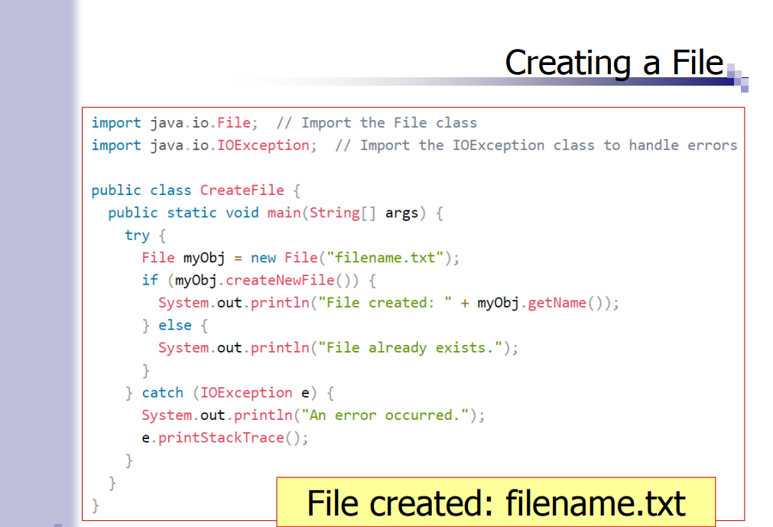

Slide 7
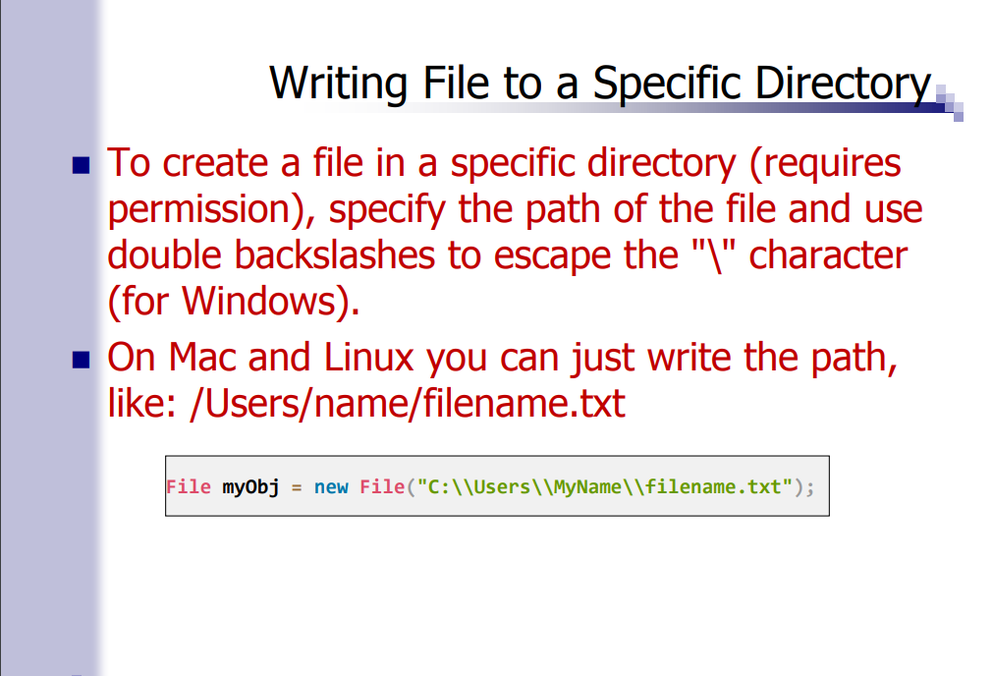

Slide 8
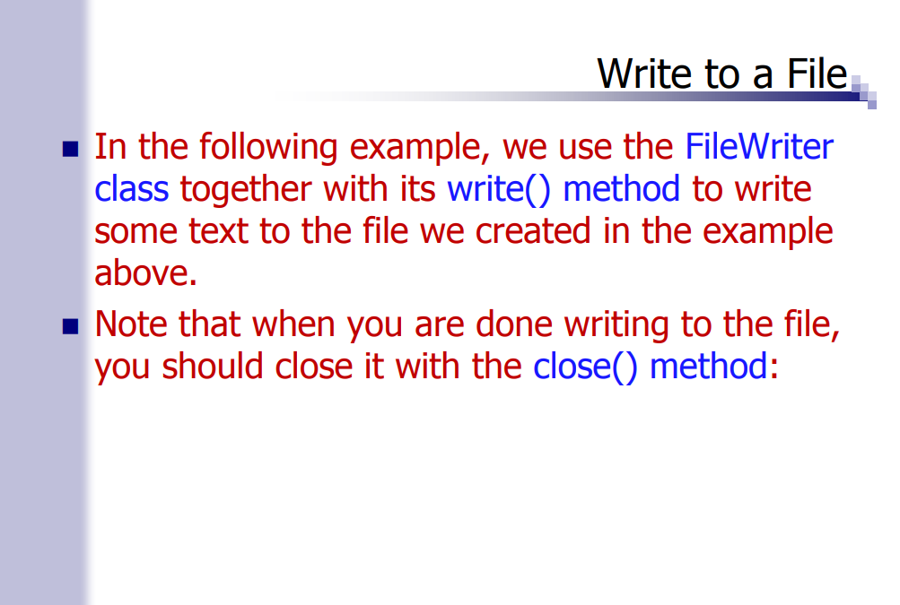

Slide 9
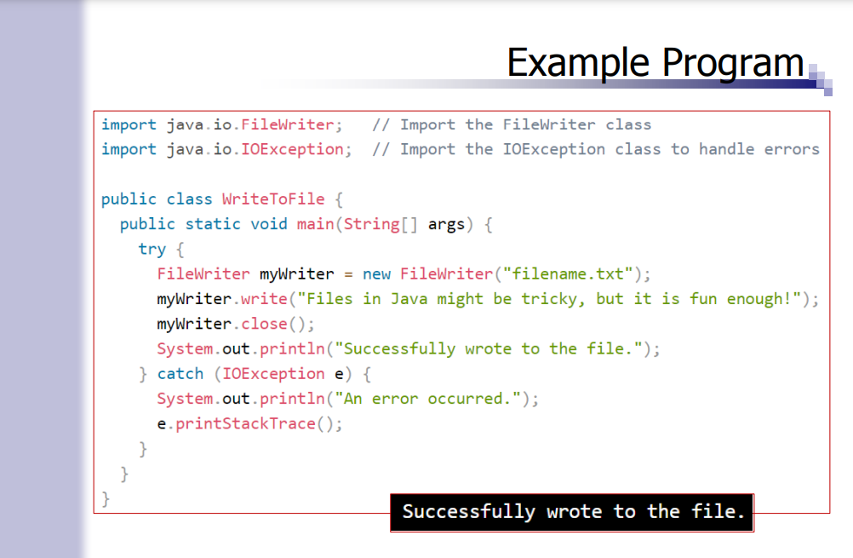

Slide 10
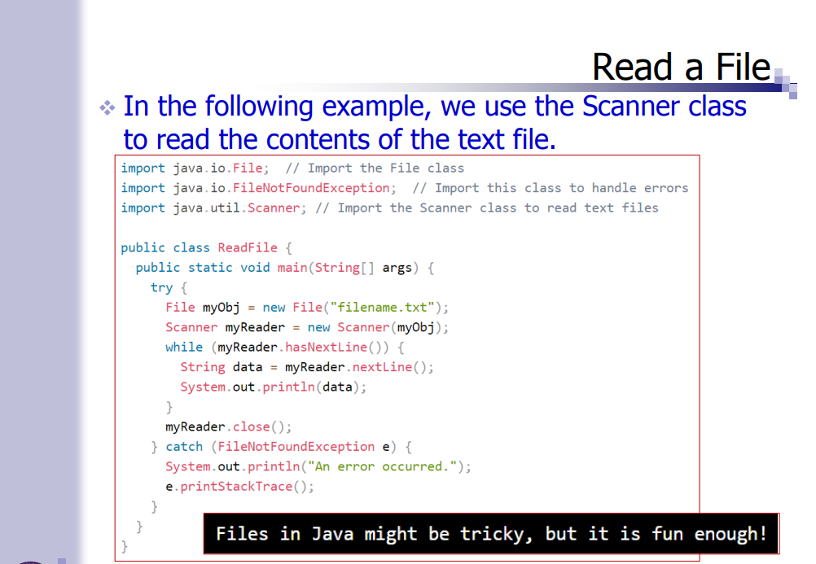

Slide 11
import java.io.BufferedReader; import java.io.FileReader; import java.io.IOException; public class Main { public static void main(String[] args) { String fileName = “filename.txt"; try (BufferedReader br = new BufferedReader(new FileReader(fileName))) { String line; while ((line = br.readLine()) != null) { System.out.println(line); } } catch (IOException e) { e.printStackTrace(); } } }

Slide 12
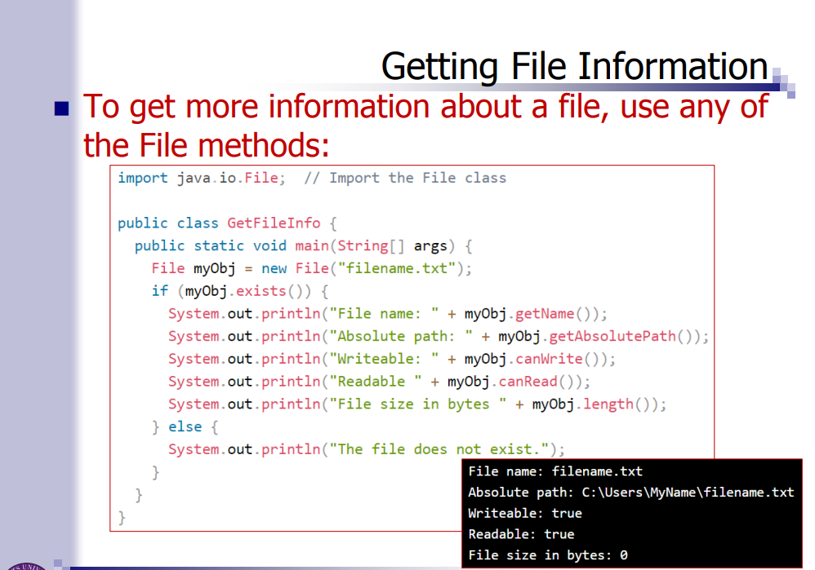

Slide 13
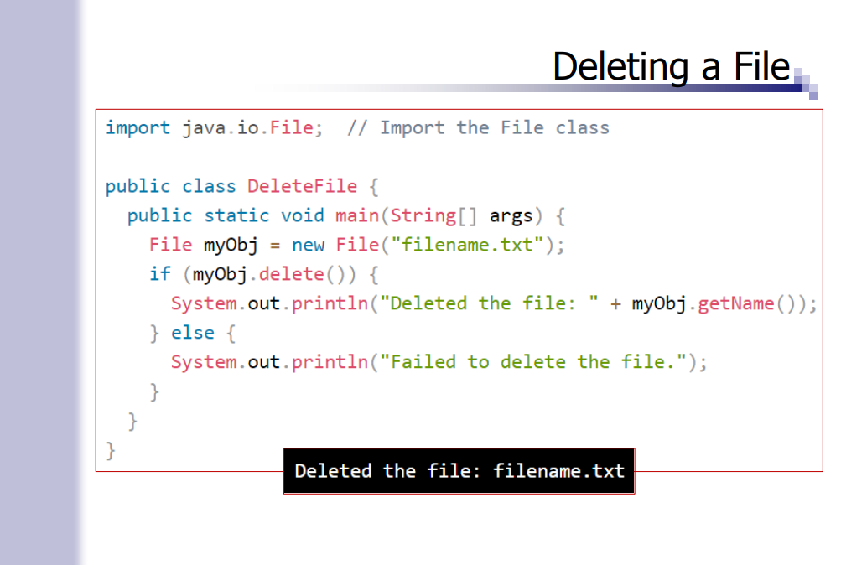

Slide 14
